Slide 1
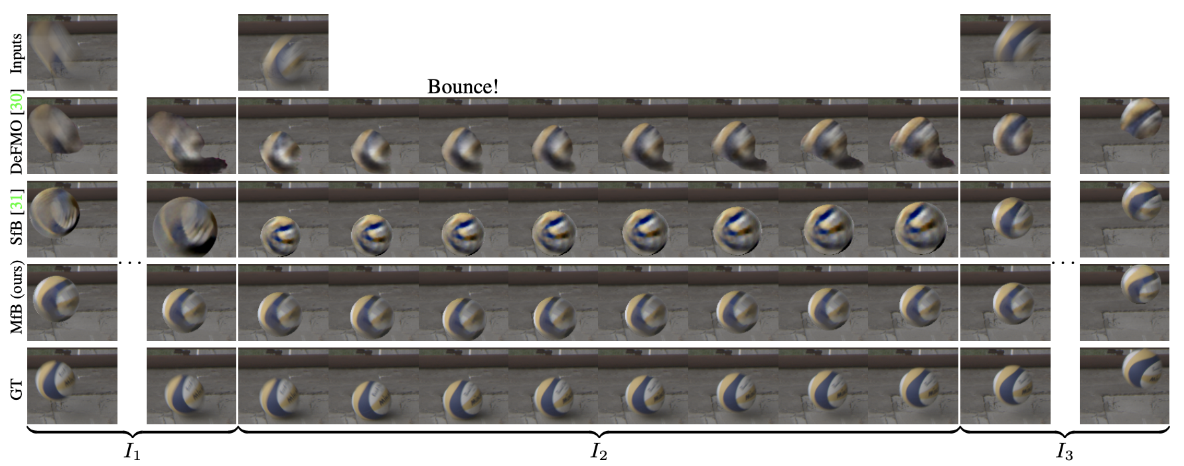
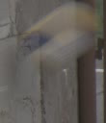
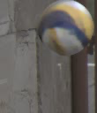
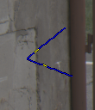
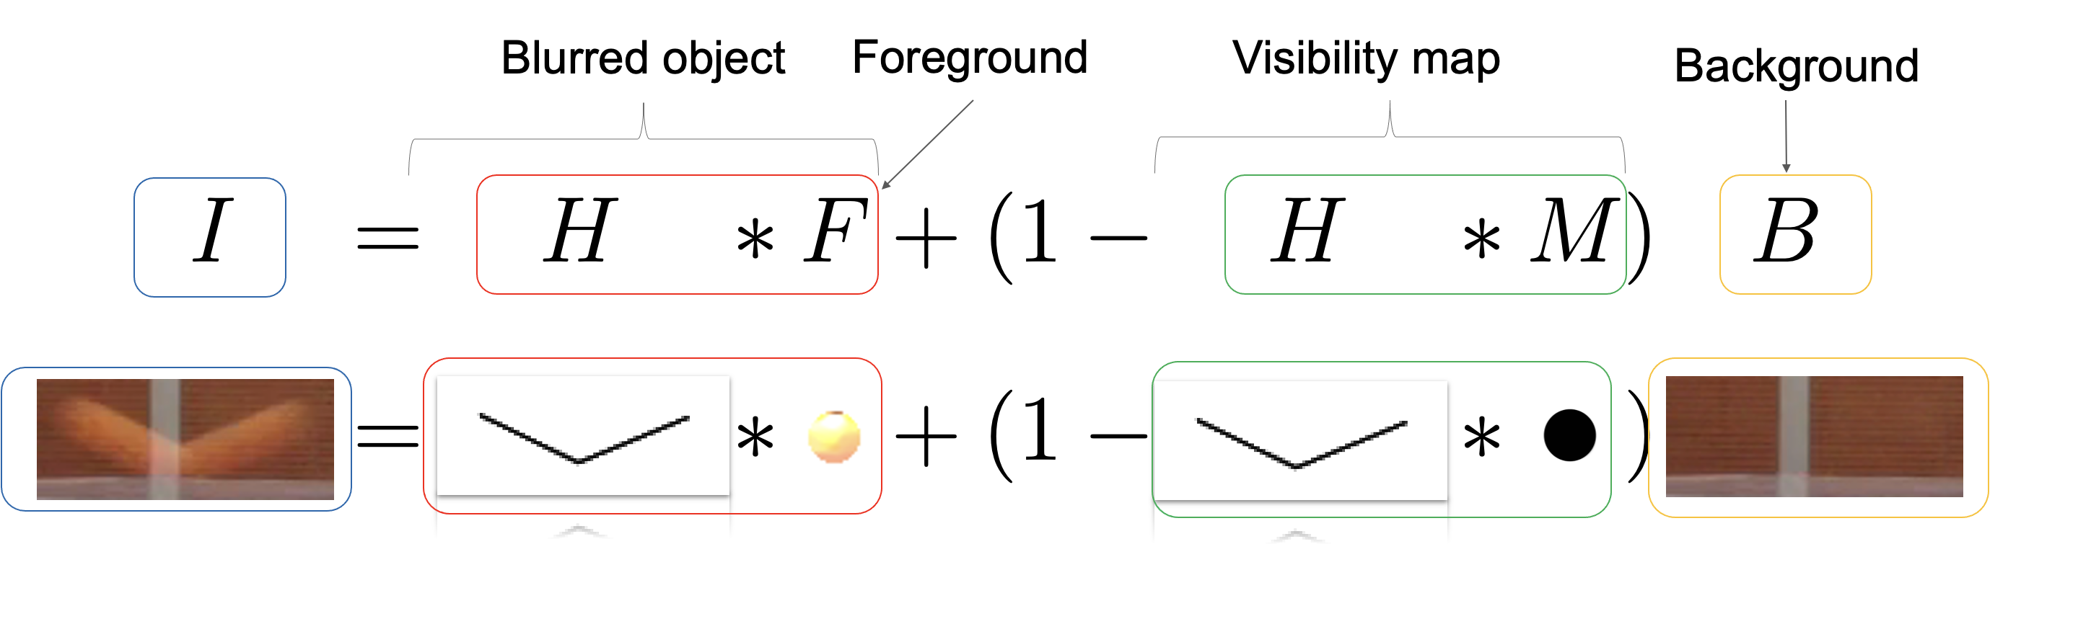
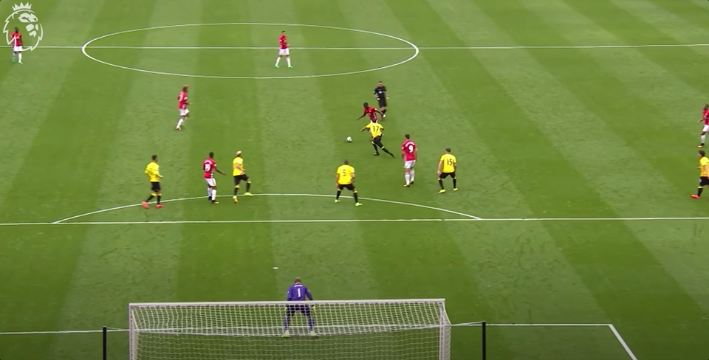

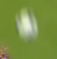
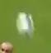
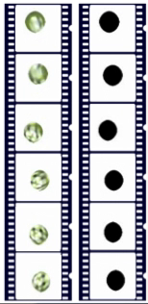
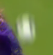
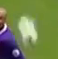

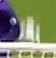
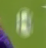
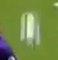
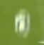
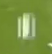
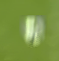
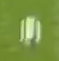
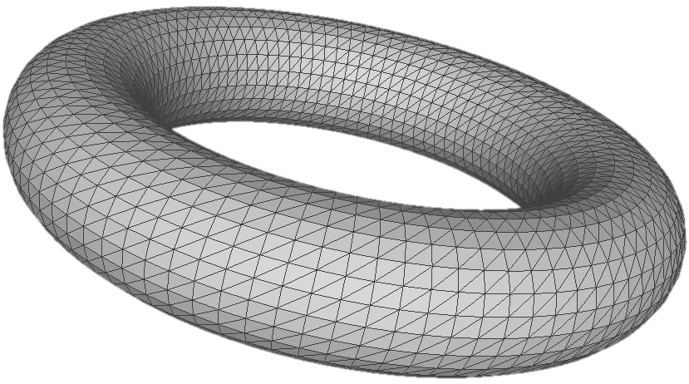
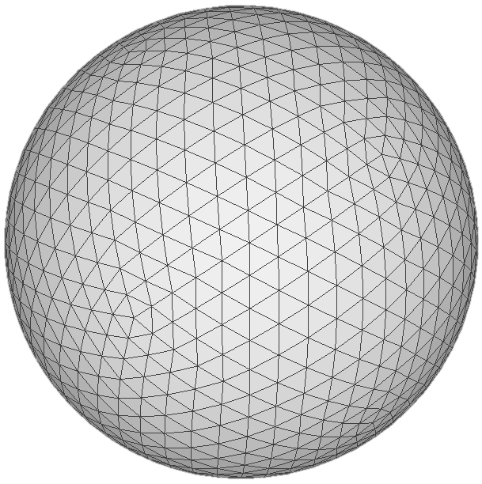
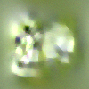
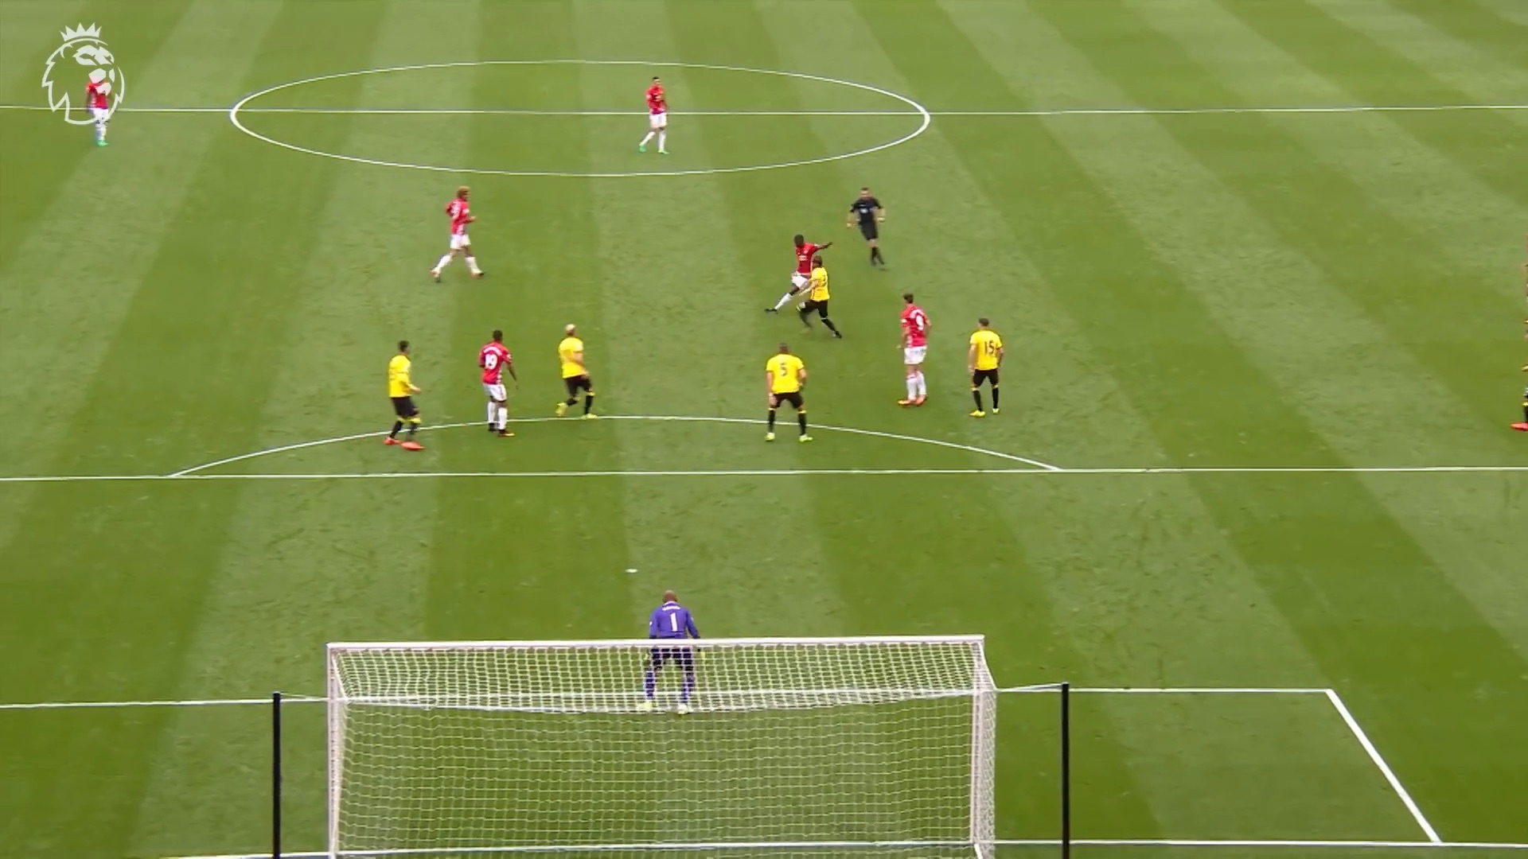
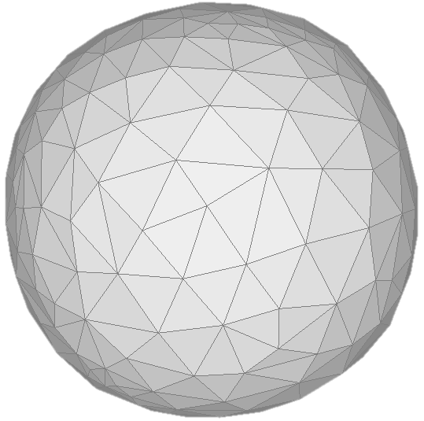



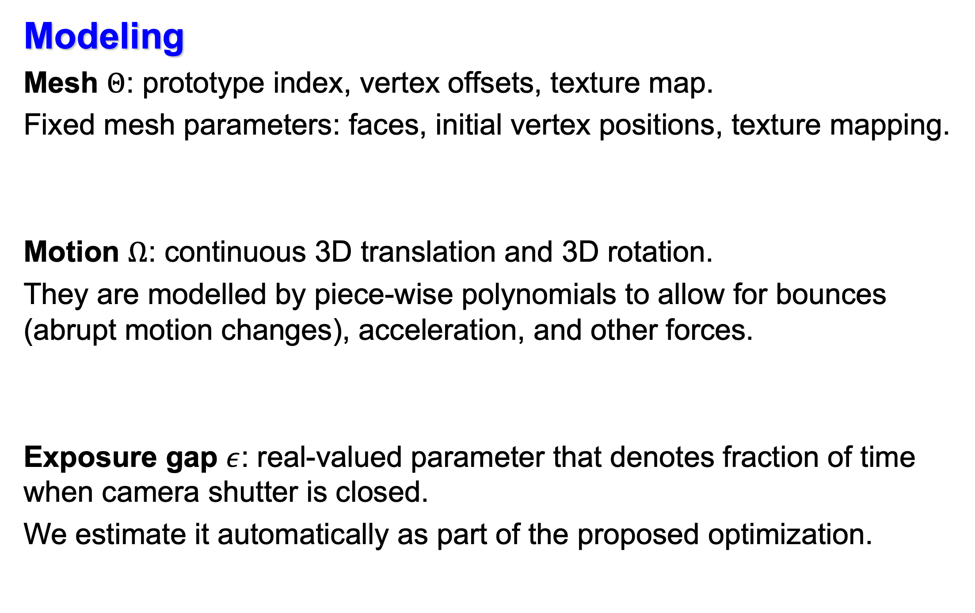
Motion-from-Blur: 3D Shape and Motion Estimation of Motion-blurred Objects in Videos Denys Rozumnyi^{1,4} Martin R. Oswald^{3,1} Vittorio Ferrari² Marc Pollefeys¹ ¹Department of Computer Science, ETH Zurich ²Google Research Zurich ³University of Amsterdam ⁴Czech Technical University in Prague
Introduction
We jointly estimate the 3D motion, 3D shape, and texture of motion-blurred objects by optimizing over multiple motion-blurred frames. Contributions:
First method to optimize over a video instead of a single frame [1-5].
Better motion modeling, e.g., with bounces and acceleration.
Explicit exposure gap modeling and its automatic estimation.
Classical motion blur problem formulation for a single frame:
Video formation with motion-blurred objects
Qualitative results
Significantly better performance at bounces:
Many frames
Exposure gap
Motion function
More complex motion
Motion blur (averaging)
Differentiable rendering
Shared parameters across frames
If we knew values of all parameters, we could render the input video!
Strict generalization of [1], who did it for a single frame and linear motion.
Model fitting
All parameters are optimized to re-render the input video as closely as possible by minimizing the pixel-wise reprojection error using differentiable rendering [6].
More complete 3D reconstruction, especially on back sides.
Bounce detection and sharper deblurring.
Input Video with Blurred Object
Cropped Input Video
Generated
Blurred Video
Generated Video
(higher frame rate)
Exposure Time
(input frame rate)
(input frame rate)
Averaging
+Matting
Foreground
Silhouettes
Exposure Gap
Averaging
+Matting
DR
Video reconstruction loss
Averaging
+Matting
DR
Padded Cropping
Averaging
+Matting
DR
Averaging
+Matting
DR
Median Filter
Blurred object
detection
Averaging
+Matting
DR
Modeling
Mesh $Θ$: prototype index, vertex offsets, texture map.
Fixed mesh parameters: faces, initial vertex positions, texture mapping.
Motion $Ω$: continuous 3D translation and 3D rotation.
They are modelled by piece-wise polynomials to allow for bounces (abrupt motion changes), acceleration, and other forces.
Exposure gap $ε$: real-valued parameter that denotes fraction of time when camera shutter is closed.
We estimate it automatically as part of the proposed optimization.
Clean
Background
Initial
Masks
Time
DR
Clean Background Video
DeFMO [2]
Silhouette loss
Motion Parameters
translation, rotation with velocity and accelation
Deblurred, Temporally Super-resolved Output
Trajectory before bounce
Bounce
time
Trajectory after bounce
Deep neural network
Constant Mesh Parameters
DR
Differentiable renderer
Loss function
Laplacian shape regulariation loss
Prototypes
Mesh
Texture Map
Data
Op
Image Operation
Bounce!
Texture smoothness loss
Quantitative results
New state-of-the-art on fast moving object deblurring benchmark [2].
Compared to a single-frame approach [1]:
Implementation and more results on GitHub:
References
[1] D. Rozumnyi et al.: Shape from Blur @ NeurIPS 2021
[2] D. Rozumnyi et al.: DeFMO @ CVPR 2021
[3] D. Rozumnyi et al.: FMODetect @ ICCV 2021
[4] D. Rozumnyi et al.: TbD-3D @ CVPR 2020
[5] J. Kotera et al.: Restoration of Fast Moving Objects @ TIP 2020
[6] W. Chen et al.: DIBR @ NeurIPS 2019
Table 1: deblurring quality at bounces.
Table 2: evaluating 3D translation, 3D rotation, and 3D shape on a synthetic dataset.
Notes:
video.png

